Slide 1
Official holidays of Ukraine
The presentation was prepared by:
Saveliev A. A., Dean of the Educational Institute of Foreign Citizens Training
Kunitsyn M. V., Deputy Dean of the Educational Institute of Foreign Citizens Training

Slide 2
Independence Day of Ukraine
On August 24, 1991, Ukraine declared independence.

Slide 3
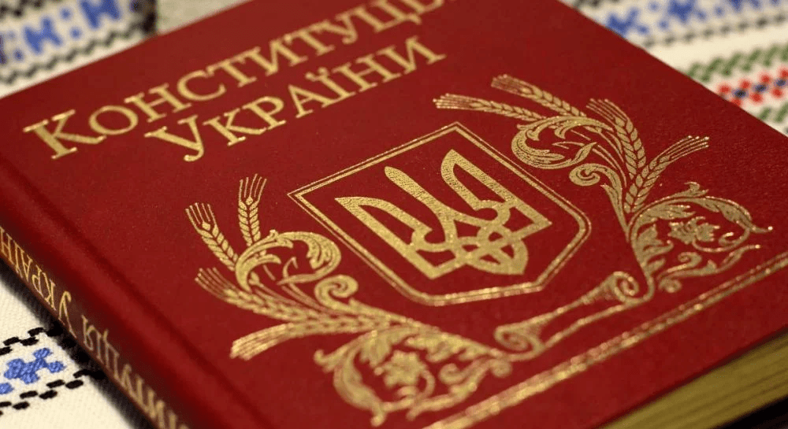
Constitution Day
On June 28, 1996, Ukraine adopted a new constitution.

Slide 4
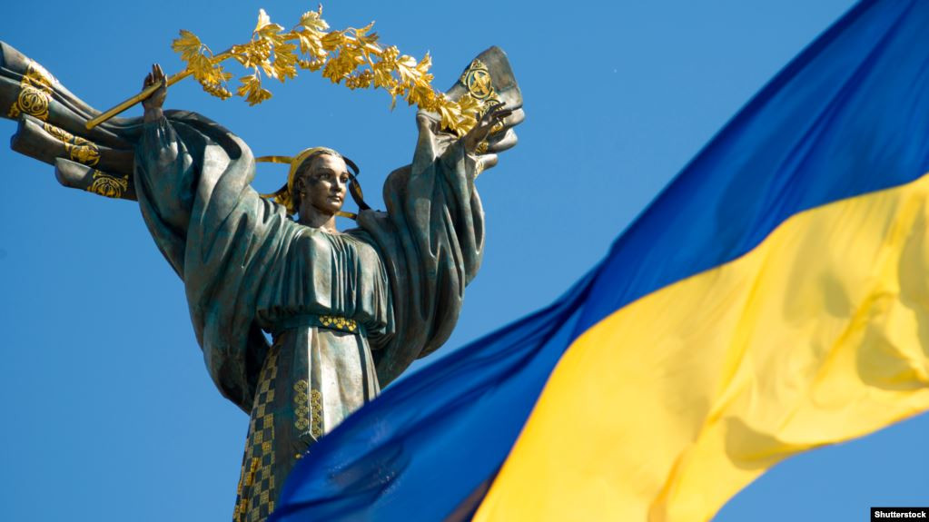
Defender of Ukraine day
October 14 is the day of the defender of Ukraine and the Ukrainian Cossacks.
Cossacks are heroes of Ukraine who fought for the freedom and independence of Ukraine in the 16th and 17th centuries.

Slide 5
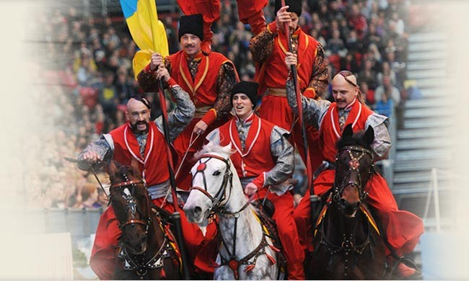
Defender of Ukraine day
Traditionally, festivals and sports and patriotic competitions are held on this day.

Slide 6
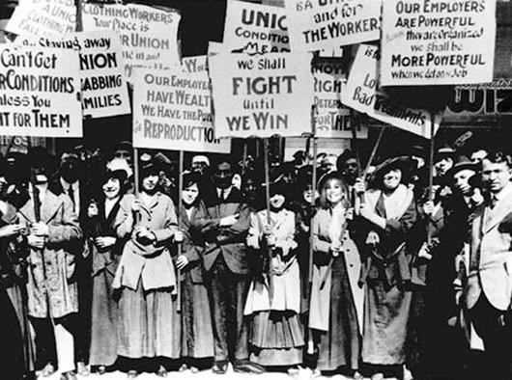
March 8 - International Women's day
March 8 is a holiday when men give flowers and gifts to all women.
1910. International Conference in Copenhagen
(in Denmark). Women all over the world are fighting for their rights: economic, political and social, etc.

Slide 7
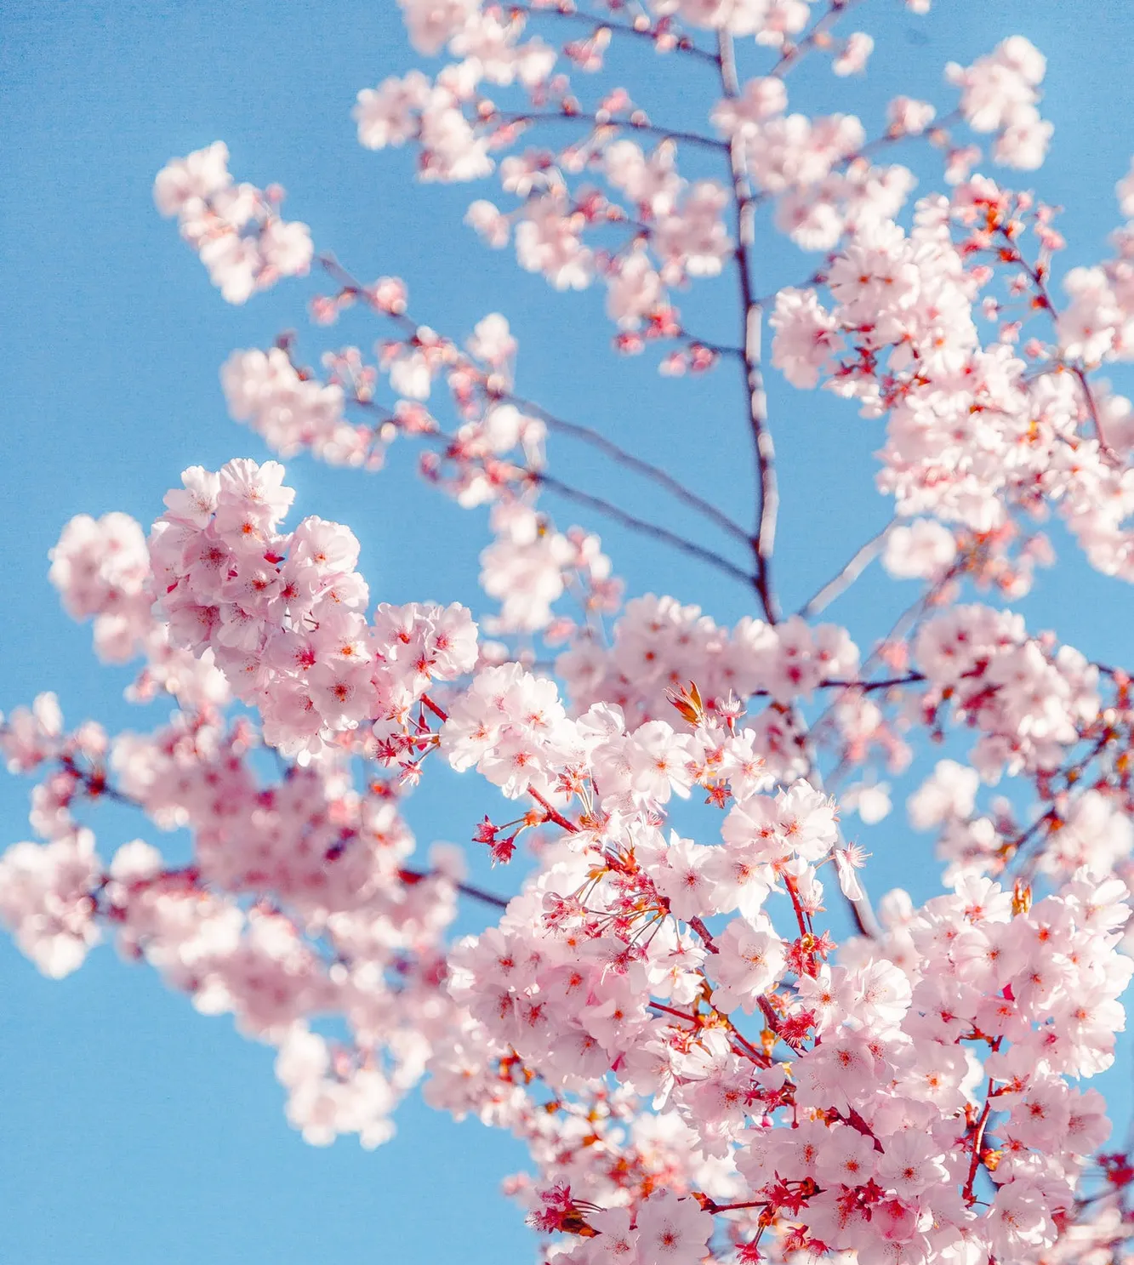
May 1 - Spring and labor holiday
Initially, this holiday was political.
On May 1, 1886, workers from the city of Chicago came out to demonstrate. They wanted to raise wages and reduce the working day to 8 hours. Instead, the police started shooting at the workers.
May 1 was named the day of solidarity of workers around the world. Today, this holiday is celebrated in 142 countries.

Slide 8
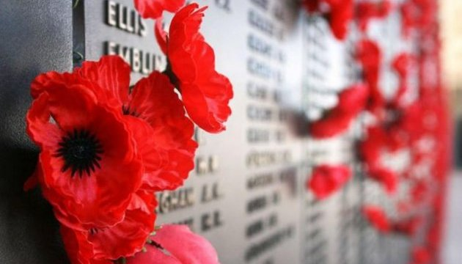
May 9 - Victory Day
Victory Day is a memory of those who liberated the world from fascism. Ukraine lost about 10 million people. Eternal memory to those who defended our future!

Slide 9
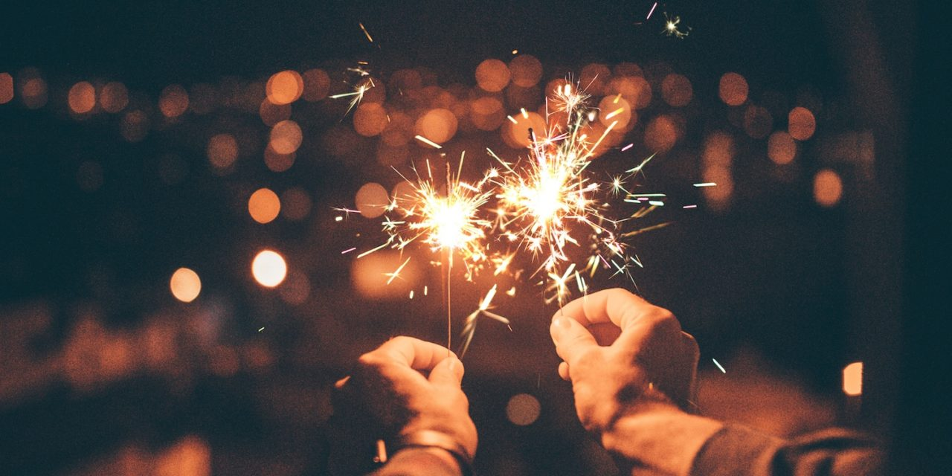
New year's Eve
New year's Eve is a winter fairy tale. The main characters are Santa Claus and his granddaughter Snegurochka.

Slide 10
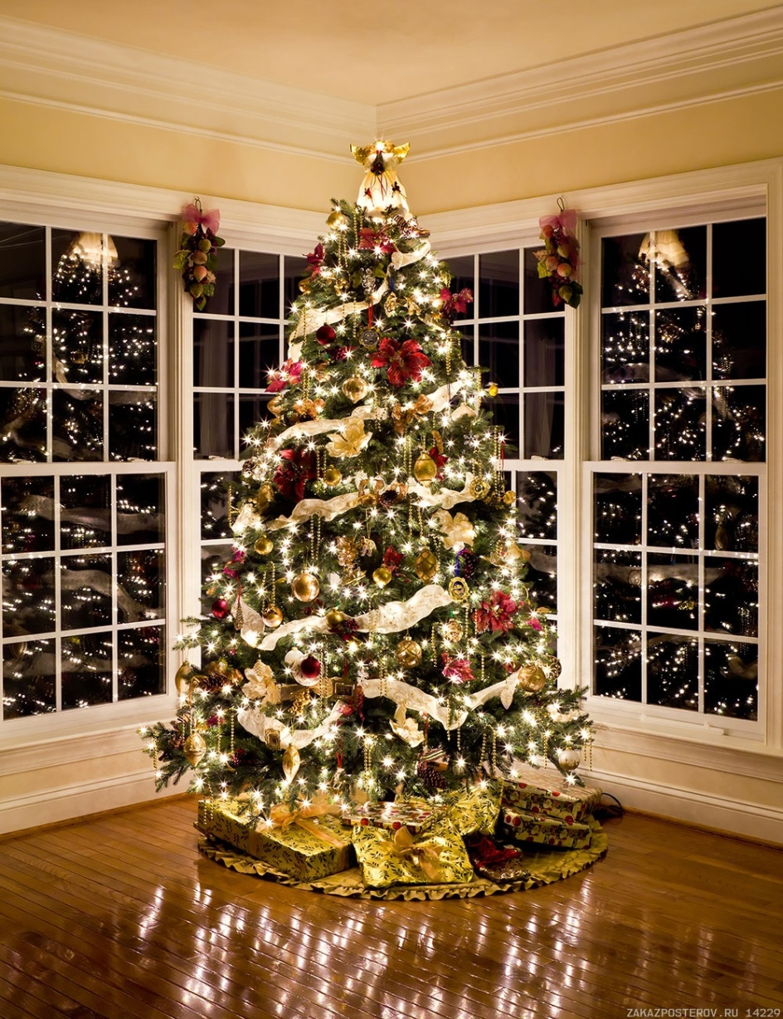
New year's Eve
Christmas trees and gifts are the main attributes of the New Year.
The tradition of celebrating the new year from December 31 to January 1 began in 1699. The Russian Emperor Peter I decided so that it would be like in Europe.
The new year is a family holiday. The whole family gathers at the festive table on New Year's Eve, rejoices, gives gifts.
At precisely midnight, they raise their champagne glasses and say: "Happy New Year! Happy New Year!"

Slide 11
THANKS
Does anyone have any questions?
Follow Us on Social Media
dec.ipig@opu.ua
opu.ua
fspirki.opu.ua
facebook.com/IPIG.ONPU
Project manager: lebedmy@gmail.com
The presentation was prepared by:
Saveliev A. A., Dean of the Educational Institute of Foreign Citizens Training
Kunitsyn M. V., Deputy Dean of the Educational Institute of Foreign Citizens Training

